Slide 1


COM Fundamentals (Client)
COM Programming
Notes:
Page <number>
WNCOMPG-2 v1.5
Chapter 3, COM Fundamentals (Client)

Slide 2


Chapter Overview
Objective
  Introduce the fundamentals of a COM client
Chapter content
  Interfaces and interface identifiers
  The IUnknown interface
  Reference counting
  HRESULTs
Practical content
  Test a simple reusable component using C++
Summary
Notes:
Page <number>
WNCOMPG-2 v1.5
Chapter 3, COM Fundamentals (Client)

Slide 3
COM Basics
A COM object
  Separates its interface(s) from its implementation
  Provides multiple services through separate interfaces
All COM objects implement an interface IUnknown
  Includes a QueryInterface() function that clients can use to acquire pointers to COM object's other interfaces
  Also includes AddRef() and Release() functions for reference counting
IUnknown
Client
Object
QueryInterface
Supported interfaces
use a supported interface
COM
Object
Notes:
Page <number>
WNCOMPG-2 v1.5
Chapter 3, COM Fundamentals (Client)

Slide 4
Interfaces
Virtual function table
pISpy
vtbl pointer
&Function1
m_data1
&Function2
Implementation
of interface
functions
m_data2
&Function3
C++ classes can
manipulate instance
data directly. COM
classes can’t!
Interface ISpy
Virtual function table
pISpy
vtbl pointer
&QueryInterface
m_data1
&AddRef
IUnknown
m_data2
&Release
ISpy
&Function1
All interfaces derive from IUnknown
&Function2
ISpy : IUnknown
&Function3
Notes:
Page <number>
WNCOMPG-2 v1.5
Chapter 3, COM Fundamentals (Client)

Slide 5
The IUnknown Interface
Base interface
  An abstract base class (contains only pure virtual-functions)
  Must be implemented by all COM objects
32-bit result code
(S_OK or E_NOINTERFACE)
Win32 standard calling convention
Interface identifier (a GUID)
of requested interface
Unknwn.h
class IUnknown {
public:
virtual HRESULT __stdcall QueryInterface(const IID& iid,
void **ppvObject) = 0;
virtual ULONG __stdcall AddRef() = 0;
virtual ULONG __stdcall Release() = 0;
};
New value of reference count
(Should not be relied upon)
Pointer to pointer to requested interface
Notes:
Page <number>
WNCOMPG-2 v1.5
Chapter 3, COM Fundamentals (Client)

Slide 6
HRESULTs
Interface functions should not throw Win32 or C++ exceptions
  Not meaningful to all types of clients
  Cannot cross process boundaries
Instead, interface functions should return an HRESULT
  32-bit value that contains success or error code
  AddRef() and Release() are only exceptions to this rule
31
30
29
28
27
26
16
15
0
S
R
C
N
r
Facility
Return code
Reserved bits
Success or error code
Source of error:
FACILITY_ITF for interface-specific error codes
Severity bit:
0 = success; 1 = failure
Notes:
Page <number>
WNCOMPG-2 v1.5
Chapter 3, COM Fundamentals (Client)

Slide 7


Interface IDs
Each interface is uniquely identified by an IID
  128-bit Globally Unique ID (GUID)
  Statistically unique over space and time
  Generated only once when you define an interface
Various formats can be used
  Registry format
  Symbolic formats (for use in C++ source)
{B0AE33A0-BC51-11d2-9BF5-000000000000}
// {B0AE33A0-BC51-11d2-9BF5-000000000000}
DEFINE_GUID(<<name>>,
0xb0ae33a0, 0xbc51, 0x11d2, 0x9b, 0xf5, 0x0, 0x0, 0x0, 0x0, 0x0, 0x0);
// {B0AE33A0-BC51-11d2-9BF5-000000000000}
static const GUID <<name>> =
{ 0xb0ae33a0, 0xbc51, 0x11d2, { 0x9b, 0xf5, 0x0, 0x0, 0x0, 0x0, 0x0, 0x0 } };
Notes:
Page <number>
WNCOMPG-2 v1.5
Chapter 3, COM Fundamentals (Client)

Slide 8
Using QueryInterface()
Use IID to specify required interface
  IID_IAccount is a variable of type IID (GUID)
IAccount *pIAccount = 0;
HRESULT hr = pIUnkown->QueryInterface( IID_IAccount,
(void**) &pIAccount );
Important to remember
  Must pass in address of interface pointer
  Have to cast interface pointer to a void**
Notes:
Page <number>
WNCOMPG-2 v1.5
Chapter 3, COM Fundamentals (Client)

Slide 9
Reference Counting
COM object determines its own lifetime
  Maintains a reference count
  Incremented by a call to AddRef() or a successful call to QueryInterface()
  Decremented by a call to Release()
  When all reference counts drop to zero, deletes itself
Clients of COM objects must follow the rules:
  Call AddRef() after duplicating an interface pointer
  Call Release() when an interface is no longer required
  Failure to follow these rules can result in memory leaks!
interface IUnknown {
STDMETHOD(QueryInterface)(REFIID riid, void **ppv) PURE;
STDMETHOD_(ULONG, AddRef)() PURE;
STDMETHOD_(ULONG, Release)() PURE;
};
Notes:
Page <number>
WNCOMPG-2 v1.5
Chapter 3, COM Fundamentals (Client)

Slide 10
Class Factories
A COM Class (or coclass), is a named body of code
  That implements one or more COM interfaces
All coclasses are identified by a CLSID (GUID)
All coclasses have an associated "class factory"
  Often implementing IClassFactory
  These are often referred to as "class objects"
COM Server
Class
Factory 1
Class
Object n
COM Object
1
COM Object
n
Notes:
Page <number>
WNCOMPG-2 v1.5
Chapter 3, COM Fundamentals (Client)

Slide 11
The IClassFactory Interface
Standard interface
  Derived from IUnknown
  Implemented by 99% of class objects
Only used with aggregation.
Otherwise, pass NULL
virtual HRESULT STDMETHODCALLTYPE (method)
interface IClassFactory : public IUnknown {
STDMETHOD(CreateInstance)(IUnknown* pUnknownOuter,
REFIID riid, void **ppv) PURE;
STDMETHOD(LockServer)(BOOL fLock) PURE;
};
TRUE: lock server in memory
FALSE: release server
Requested interface
Pointer to pointer to requested interface
Notes:
Page <number>
WNCOMPG-2 v1.5
Chapter 3, COM Fundamentals (Client)

Slide 12
Activation API
CLSID uniquely
identifying coclass
Context for new object
HRESULT CoGetClassObject( REFCLSID rclsid,
DWORD dwClsCtx,
COSERVERINFO *pcsi,
REFIID riid,
void **ppv );
NULL indicates
local machine
Returned interface pointer
Required interface
Notes:
Page <number>
WNCOMPG-2 v1.5
Chapter 3, COM Fundamentals (Client)

Slide 13
Using CoGetClassObject
CoInitialize( 0 ); // initialise COM runtime
IClassFactory *pIFactory = 0;
HRESULT hr = CoGetClassObject( CLSID_Account,
CLSCTX_INPROC_SERVER,
NULL,
IID_IClassFactory,
(void**)&pIFactory );
if( SUCCEEDED( hr ) ) {
// create the COM object
IAccount *pIAccount = 0;
hr = pIFactory->CreateInstance( NULL, // no aggregation
IID_IAccount,
(void**)&pIAccount );
pIFactory->Release(); // finished with class factory
if( SUCCEEDED( hr ) ) {
// Do something with our IAccount interface pointer
...
pIAccount->Release();
}
}
CoUninitialize();
Notes:
Page <number>
WNCOMPG-2 v1.5
Chapter 3, COM Fundamentals (Client)

Slide 14
Activation APIs
CLSID uniquely
identifying coclass
Controlling IUnknown
for aggregates
HRESULT CoCreateInstance( REFCLSID rclsid,
IUnknown *pIUnkOuter,
DWORD dwClsCtx,
REFIID riid,
void **ppv );
Context for new object
Required interface
Returned interface pointer
Specifies IClassFactory, then calls
IClassFactory::CreateInstance
HRESULT CoGetClassObject( REFCLSID rclsid,
DWORD dwClsCtx,
COSERVERINFO *pcsi,
REFIID riid,
void **ppv );
NULL indicates
local machine
Notes:
Page <number>
WNCOMPG-2 v1.5
Chapter 3, COM Fundamentals (Client)

Slide 15
Implementing a COM Client
CoInitialize( 0 ); // initialise COM runtime
// Create Object
IUnknown *pIUnk = 0;
HRESULT hr = CoCreateInstance( CLSID_Account,
NULL,
CLSCTX_INPROC_SERVER,
IID_IUnknown,
(void**)&pIUnk );
if( SUCCEEDED( hr ) ) {
// query for required interface
IAccount *pIAccount = 0;
hr = pIUnk->QueryInterface( IID_IAccount, (void**)&pIAccount );
pIUnk->Release(); // finished with IUnknown
if( SUCCEEDED( hr ) ) {
// Do something with our IAccount pointer
...
pIAccount->Release();
}
}
CoUninitialize();
Notes:
Page <number>
WNCOMPG-2 v1.5
Chapter 3, COM Fundamentals (Client)

Slide 16
Other Clients
COM is about component development and reuse
Consequently, COM must support non C++ clients
  e.g. Visual Basic, VB Script and JavaScript
These environments provide excellent support for COM
Scripting
Engines
COM Object
Visual Basic
Notes:
Page <number>
WNCOMPG-2 v1.5
Chapter 3, COM Fundamentals (Client)

Slide 17
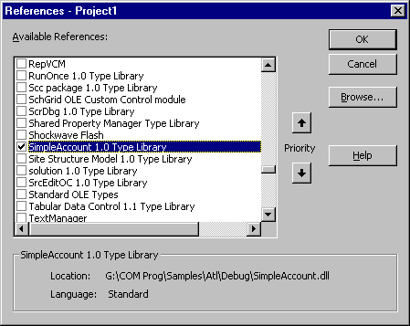
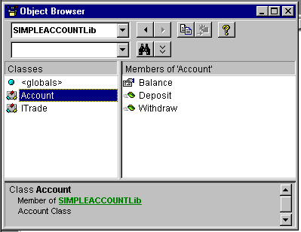
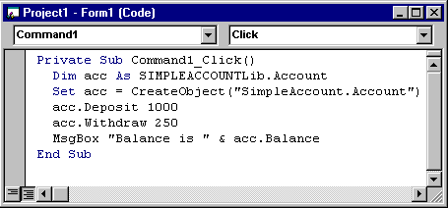
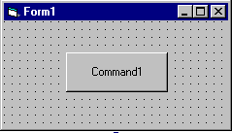

A Simple Early-Binding VB Client
Notes:
Page <number>
WNCOMPG-2 v1.5
Chapter 3, COM Fundamentals (Client)

Slide 18
Summary
IUnknown, the COM base interface, defines 3 functions
  QueryInterface(), AddRef() and Release()
QueryInterface() allows a client to request a pointer to a specified interface
AddRef() and Release() to control objects lifetime
  AddRef() after replicating a interface pointer
  Release() when it is no longer needed
Every COM interface is identified by an IID
  A 128-bit GUID unique over space and time
All interface functions, should return an HRESULT
  32-bit value that contains success or error code
  Use CoCreateInstance() to create the object
Notes:
Page <number>
WNCOMPG-2 v1.5
Chapter 3, COM Fundamentals (Client)

